Slide 1
NHN Cloud
Architecture Icons
v.2.0
June 25, 2024

Slide 2
Contents
Light Backgrounds
General Resources
  Title Bar
  Groups
  Arrows
  Icons
Dark Backgrounds
General Resources
  Title Bar
  Groups
  Arrows
  Icons
Service Icon (Common for Light and Dark)
Compute
Container
Network
Storage
Database
Hybrid & Private Cloud
Game
Content Delivery
Notification
AI Service
Machine Learning
Applications Service
Mobile Service
Search
Data & Analytics
Dev Tools
Management
Bill
  Dooray!
  Dooray! | ERP
  Dooray! | Groupware
  Contact Center
  IDC
  Governance & Audit
  Security
  Marketplace

Slide 3
Light Backgrounds

Slide 4









Light Backgrounds > General Resources (Title Bar / Groups / Arrows)
Enter Title Bar Text
NHN Cloud
Region
Organization
Project
VPC
Private subnet
Public subnet
Availability Zone
Auto Scaling group
On-Premise/IDC
/Co-lo Zone
Main Path
Secondary Path
Success Status
Optional Main Path
Optional Secondary Path
Failure Status

Slide 5















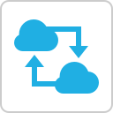

Light Backgrounds > General Resources (Icons)
External User
Internal User
Administrator
Desktop
Desktop+Phone
Laptop
Phone
Mobile Devices
Gateway
NHN Cloud
Subnet
Internet
Gateway
NAT Gateway
Routing Table
Private Network
Peering
Interface

Slide 6














Light Backgrounds > General Resources (Icons)
Organization
Project
NHN Cloud
Member
Owner
Admin
Member
Billing Viewer
Log Viewer
IAM Member
Admin
Member
Viewer
IP ACL
Login Security
Settings

Slide 7
Dark Backgrounds

Slide 8


Dark Backgrounds > General Resources (Title Bar / Groups / Arrows)
Enter Title Bar Text
NHN Cloud
Region
Organization
Project
VPC
Private subnet
Public subnet
Availability Zone
Auto Scaling group
On-Premise/IDC
/Co-lo Zone
Main Path
Secondary Path
Success Status
Optional Main Path
Optional Secondary Path
Failure Status

Slide 9














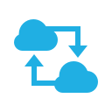

Dark Backgrounds > General Resources (Icons)
External User
Internal User
Administrator
Desktop
Desktop+Phone
Laptop
Phone
Mobile Devices
Gateway
NHN Cloud
Subnet
Internet
Gateway
NAT Gateway
Routing Table
Private Network
Peering
Interface

Slide 10














Dark Backgrounds > General Resources (Icons)
Organization
Project
NHN Cloud
Member
Owner
Admin
Member
Billing Viewer
Log Viewer
IAM Member
Admin
Member
Viewer
IP ACL
Login Security
Settings

Slide 11
Service Icon (Common for Light and Dark)

Slide 12











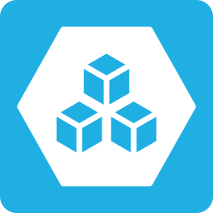
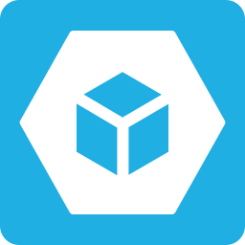

Service Icon
Compute
Compute
Compute
Instance
Ephemeral
Storage Instance
GPU Instance
Bare Metal
Instance
Instance
Template
Image
Image Builder
Auto Scale
Virtual
Desktop
Container
Container
NHN Kubernetes
Service(NKS)
NHN Container
Service(NCS)
NHN Container
Registry(NCR)

Slide 13








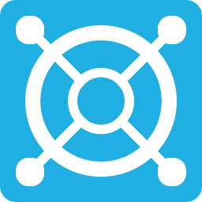







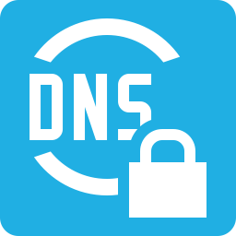
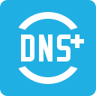








Service Icon
Network
Network
VPC
Network
Interface
Floating IP
Network ACL
Security Groups
Load Balancer
NAT Instance
Transit Hub
Internet
Gateway
Peering
Gateway
Colocation
Gateway
NAT
Gateway
VPN Gateway
(Site-to-Site VPN)
Service
Gateway
Traffic
Mirroring
Private DNS
DNS Plus
Direct Connect
Storage
Storage
Block Storage
NAS
NAS
(offline)
Object Storage
Backup
Data
Transporter

Slide 14

















Service Icon
Database
Database
RDS for
MySQL
RDS for
MariaDB
RDS for
MS-SQL
RDS for
PostgreSQL
EasyCache
MS-SQL
Instance
MySQL
Instance
PostgreSQL
Instance
CUBRID
Instance
MariaDB
Instance
Tibero
Instance
Redis
Instance
Monitoring
Monitoring
System
Monitoring
Service
Monitoring
Cloud
Monitoring

Slide 15


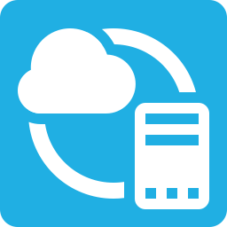
Service Icon
Hybrid & Private Cloud
Hybrid &
Private Cloud
NHN
Private Cloud
NHN
Hybrid Cloud

Slide 16
















Service Icon
Game
Game
Gamebase
GameAnvil
GameStarter
Leaderboard
Launching
Smart
Downloader
Content Delivery
Content Delivery
CDN
Image Manager
Notification
Notification
Push
SMS
RCS
Bizmessage
Email
KakaoTalk
Bizmessage

Slide 17



















Service Icon
AI Service
AI Service
Face Recognition
AI Fashion
OCR
Text to Speech
Speech to Text
Pose Estimation
Machine Learning
Machine Learning
Deep Learning
Instance
AI EasyMaker
Application Service
Application
Service
Maps
ROLE
API Gateway
RTCS
ShortURL
JEUS Instance
WebtoB
Instance
File-Crafter

Slide 18












Service Icon
Mobile Service
Mobile Service
IAP
Search
Search
Cloud Search
Autocomplete
Corporation
Search
Word
Suggestion
Data & Analytics
Data &
Analytics
Log & Crash
Search
DataFlow
DataQuery
Kafka
Instance

Slide 19









Service Icon
Dev Tools
Dev Tools
Pipeline
Deploy
Management
Management
Managed
Support Plan
Certificate
Manager
Bill
Bill
eTax

Slide 20














Service Icon
Dooray!
Dooray!
Project
Messenger
Mail
Calendar
Drive
Contacts
Wiki
Dooray! | ERP
Dooray! | ERP
Human
Resource
Finance
Dooray! | Groupware
Dooray! |
Groupware
Communication
Board
Workflow

Slide 21








Service Icon
Contact Center
Contact Center
Online
Contact
Mobile
Contact
IDC
IDC
NCC
Governance & Audit
Governance &
Audit
CloudTrail
Resource
Watcher

Slide 22















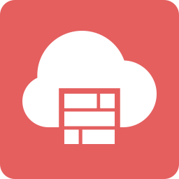

Service Icon
Security
Security
NHN AppGuard
App Security
Check
Server Security
Check
Webshell
Threat Detector
Security
Monitoring
Basic Security
CAPTCHA
WEB Firewall
Vaccine
Secure Key
Manager
Security
Compliance
DDoS Guard
SIEM
Security
Advisor
Network
Firewall
Sub icons
Firewall

Slide 23
















Service Icon
Marketplace
Storage
Database
Security
Content
Delivery
Notification
AI Service
Application
Instance
Application
Service
Data &
Analytics
Dev Tools
Management
Medical &
Healthcare
Manufacturing
Finance
Machine
Learning
IoT

Slide 24
Examples

Slide 25
Single VPC Configuration Example (Light Backgrounds)
Administrator
External User
NHN Cloud
Region
Floating IP
Floating IP
DDoS Guard
Basic Security
Security Monitoring
System Monitoring
Organization
Project
Internet
Gateway
VPC-Service
Public subnet-WEB
Private subnet-WAS
Private subnet-DB
Server Security
Check
WEB
Load Balancer
WEB
Firewall
WAS
Load Balancer
Availability Zone (A)
Log & Crach
Search
Block Storage
Management
WEB 1
WAS 1
DB 1
Object
Storage
Availability Zone (B)
Block Storage
WEB 2
WAS 2
DB 2
Backup
NAS
NAS

Slide 26
Single VPC Configuration Example (Dark Backgrounds)
Administrator
External User
NHN Cloud
Region
Floating IP
Floating IP
DDoS Guard
Basic Security
Security Monitoring
System Monitoring
Organization
Project
Internet
Gateway
VPC-Service
Public subnet-WEB
Private subnet-WAS
Private subnet-DB
Server Security
Check
WEB
Load Balancer
WEB
Firewall
WAS
Load Balancer
Availability Zone (A)
Log & Crach
Search
Block Storage
Management
WEB 1
WAS 1
DB 1
Object
Storage
Availability Zone (B)
Block Storage
WEB 2
WAS 2
DB 2
Backup
NAS
NAS

Slide 27
Multi VPC Configuration Example (Light Backgrounds)
Administrator
External User
NHN Cloud
Region
Floating IP
Floating IP
DDoS Guard
Basic Security
Security Monitoring
System Monitoring
Organization
Project
Internet
Gateway
VPC Public DMZ
VPC Private INT
VPC Private DB
Public subnet-WEB
Private subnet-WAS
Private subnet-DB
Server Security
Check
WEB
Load Balancer
WEB
Firewall
WAS
Load Balancer
Log & Crach
Search
Peering
Availability Zone (A)
Peering
Management
WEB 1
Routing
Table
Routing
Table
WAS 1
Routing
Table
Routing
Table
DB 1
Object
Storage
Availability Zone (B)
WEB 2
WAS 2
DB 2
Backup
Routing
Table
Peering
Routing
Table

Slide 28
Multi VPC Configuration Example (Dark Backgrounds)
Administrator
External User
NHN Cloud
Region
Floating IP
Floating IP
DDoS Guard
Basic Security
Security Monitoring
System Monitoring
Organization
Project
Internet
Gateway
VPC Public DMZ
VPC Private INT
VPC Private DB
Public subnet-WEB
Private subnet-WAS
Private subnet-DB
Server Security
Check
WEB
Load Balancer
WEB
Firewall
WAS
Load Balancer
Log & Crach
Search
Peering
Availability Zone (A)
Peering
Management
WEB 1
Routing
Table
Routing
Table
WAS 1
Routing
Table
Routing
Table
DB 1
Object
Storage
Availability Zone (B)
WEB 2
WAS 2
DB 2
Backup
Routing
Table
Peering
Routing
Table

